Slide 1
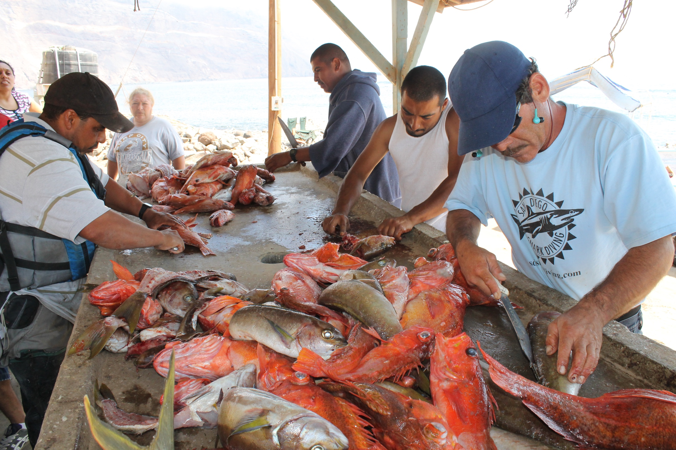




Framework to Evaluate Marine Reserves in Mexico

